Slide 1

Comparison of CNN Architectures on Different Datasets
By
Rajalakshmi mathaiyan

Slide 2
Introduction
Objective : To evaluate and compare the performance of different CNN architecture ( LeNet-5, AlexNet, GoogLeNet, VGGNet, ResNet, Xception, and SENet) on three datasets MNIST, Fashion MNIST and CIFAR-10.
Convolutional Neural Networks (CNNs) have revolutionized image recognition and classification tasks
The comparison will be based on metrics such as loss curves, accuracy, precision, recall, and F1-score.

Slide 3
Problem Statement
Compare LeNet-5, AlexNet, GoogLeNet, VGGNet, ResNet, Xception, and SENet.
Datasets: MNIST, FMNIST, CIFAR-10
Metrics: Loss curves, accuracy, precision, recall, F1-score.

Slide 4
Datasets
MNIST: Handwritten digits dataset consisting of 60,000 training images and 10,000 testing images. Each image is 28x28 pixels in grayscale.
FMNIST: Fashion MNIST dataset consisting of 60,000 training images and 10,000 testing images of fashion products. Each image is 28x28 pixels in grayscale.
CIFAR-10: Dataset consisting of 60,000 32x32 color images in 10 classes, with 50,000 training images and 10,000 testing images.

Slide 5
CNN Architectures Overview
LeNet-5: One of the first CNN models, designed for digit recognition.
AlexNet: Deeper architecture, introduced ReLU and dropout.
GoogLeNet (Inception): Uses Inception modules for efficiency.
VGGNet: Deep network with small filters (3x3).
ResNet: Introduced residual connections to solve vanishing gradient issues.
Xception: Depthwise separable convolutions for efficiency.
SENet: Introduces attention mechanisms for feature recalibration.
CIFAR-10: Dataset consisting of 60,000 32x32 color images in 10 classes, with 50,000 training images and 10,000 testing images.

Slide 6
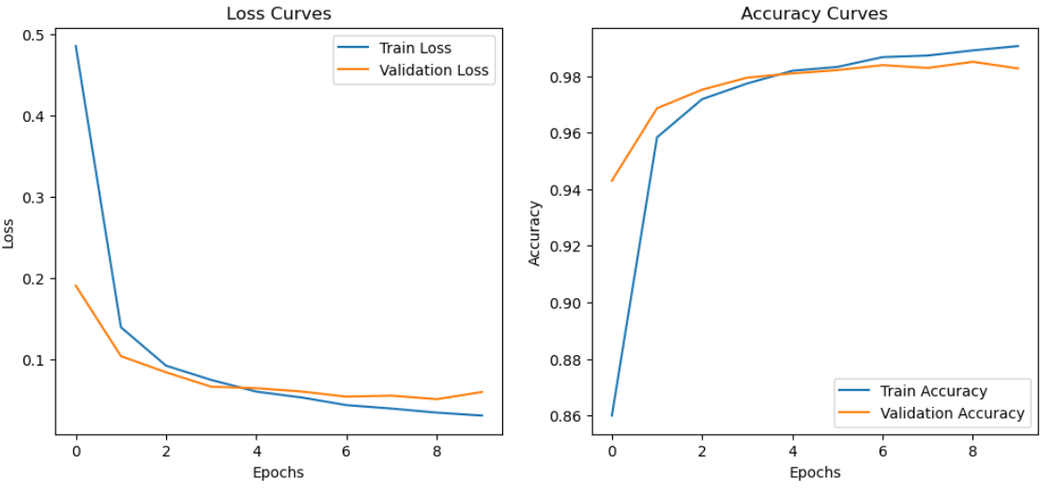
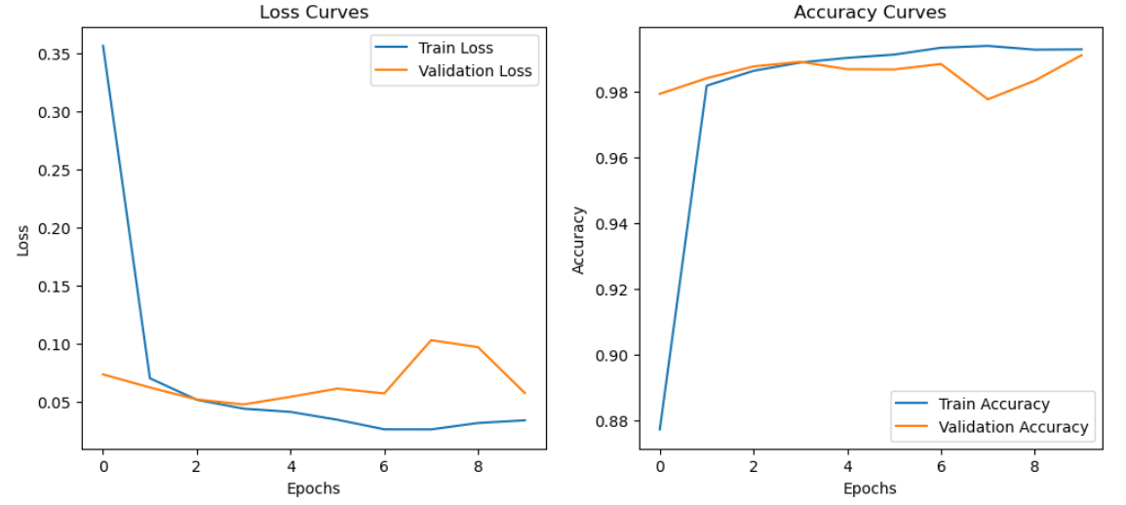
MNIST DATASET
Lenet-5 model
Alexnet model

Slide 7
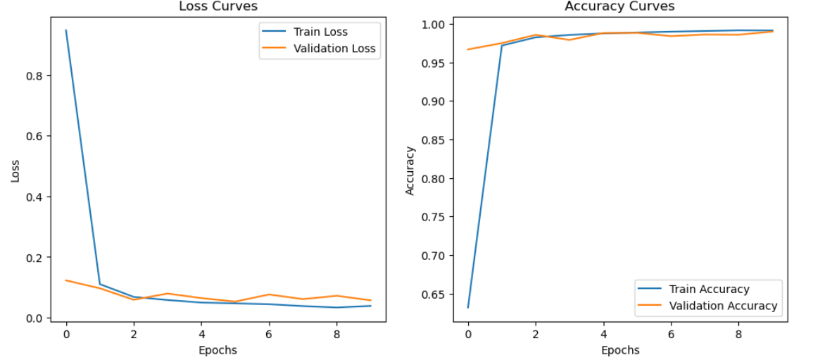
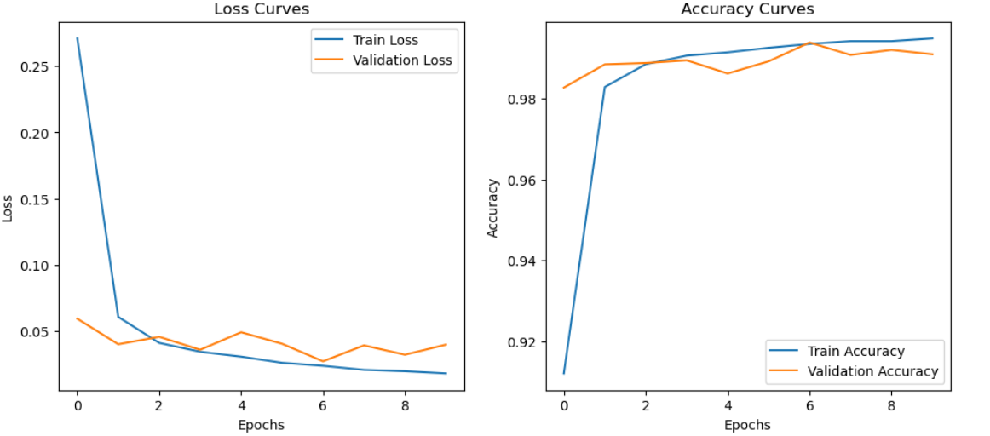
MNIST DATASET
Googlenet model
Vggnet model

Slide 8
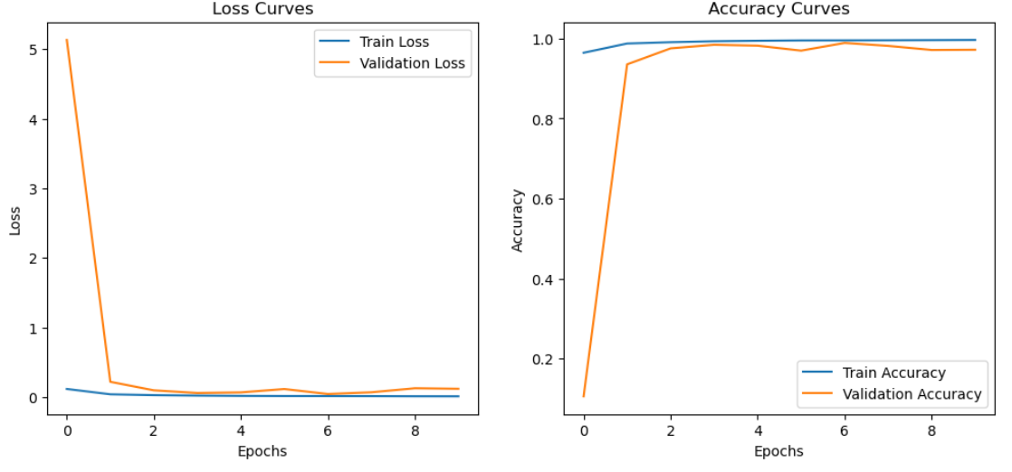
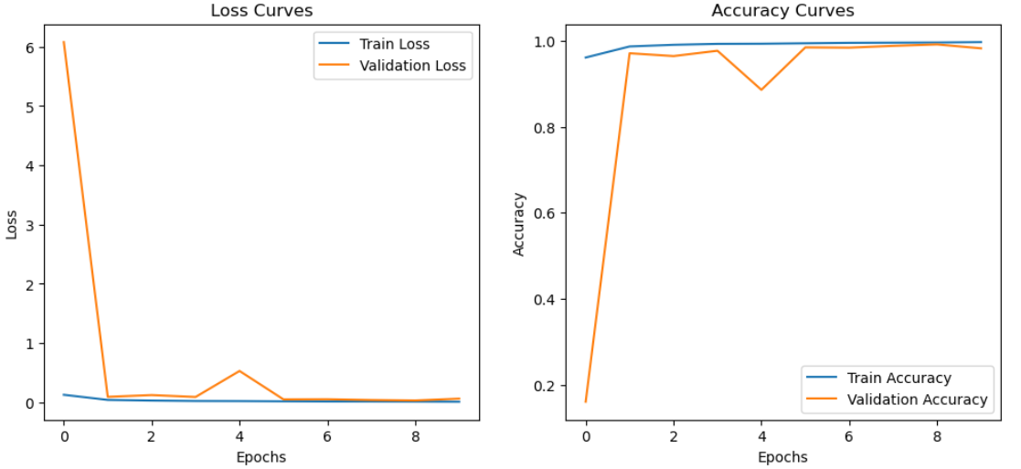
MNIST DATASET
Resnet model
Xception model

Slide 9
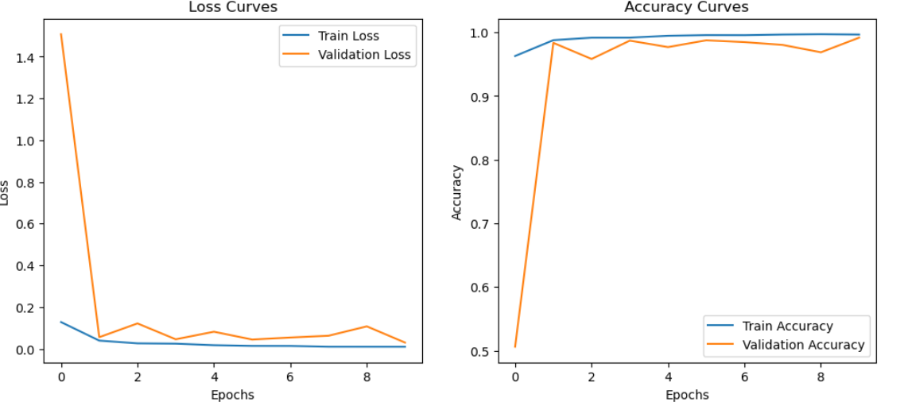
MNIST DATASET
Senet model

Slide 10
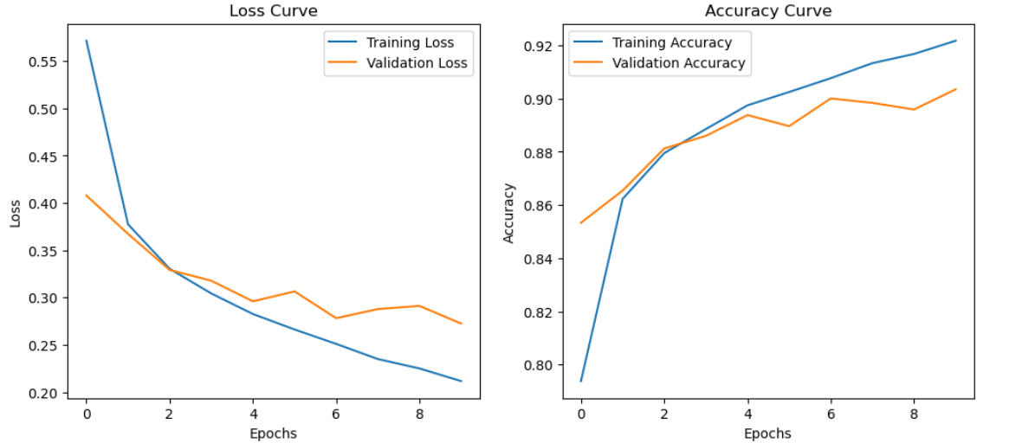
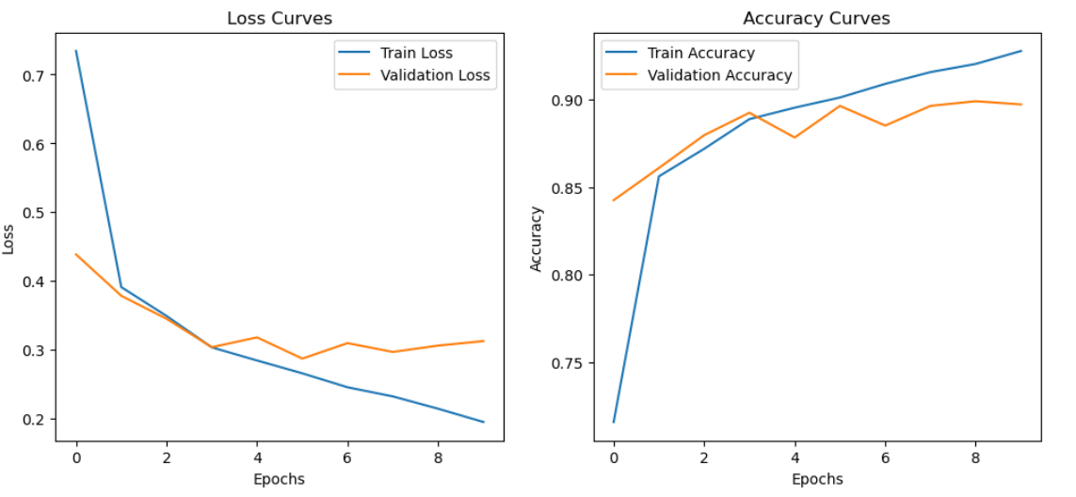
FashionMNIST DATASET
LeNet-5 MODEL
Alexnet model

Slide 11
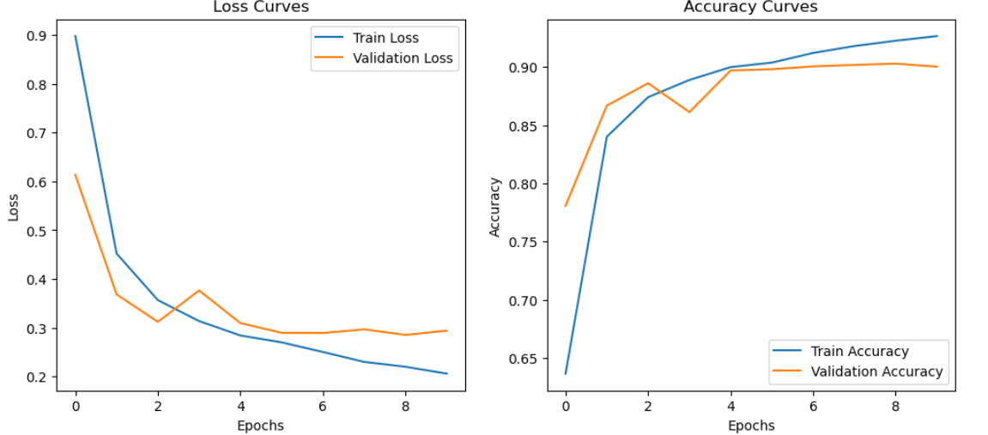
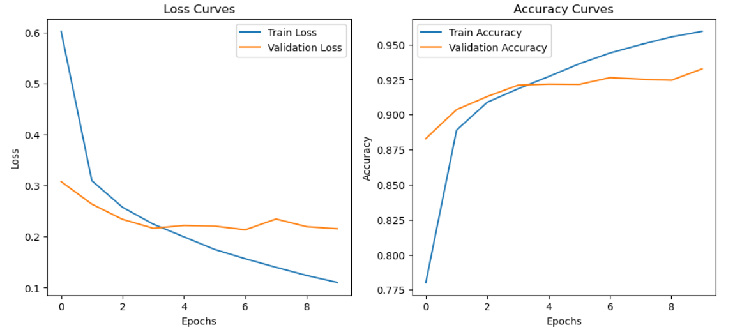
FashionMNIST DATASET
Googlenet model
Vggnet model

Slide 12
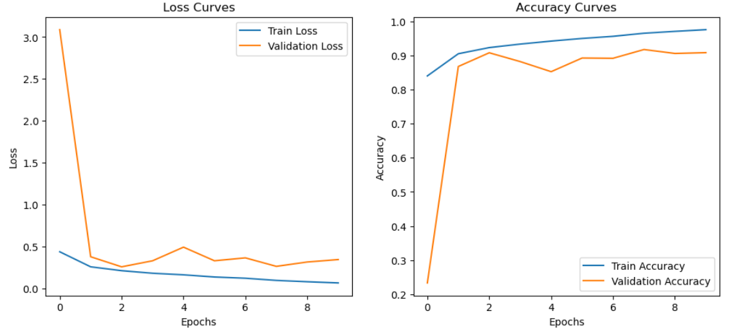
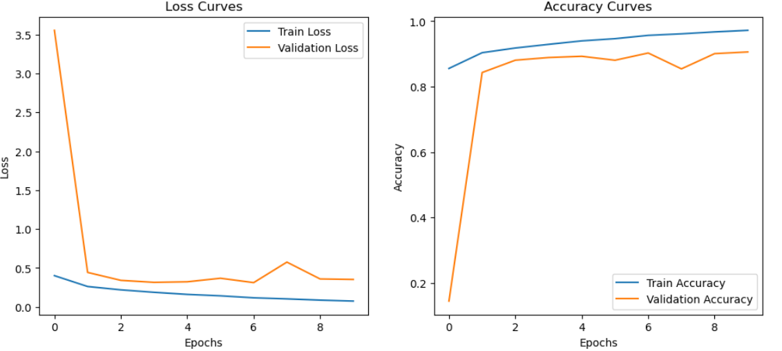
FashionMNIST DATASET
Resnet model
Xception model

Slide 13
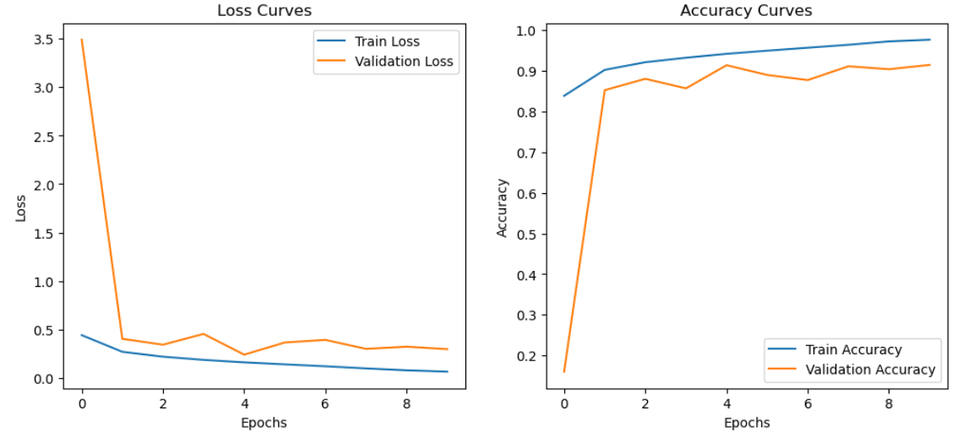
FashionMNIST DATASET
Senet model

Slide 14
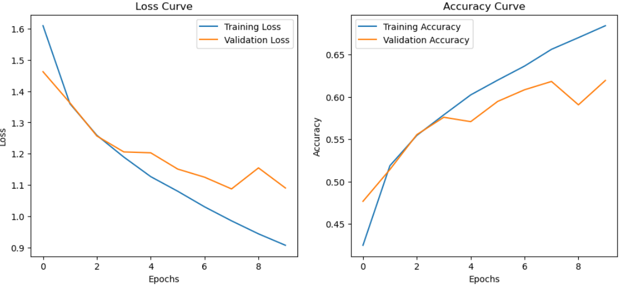
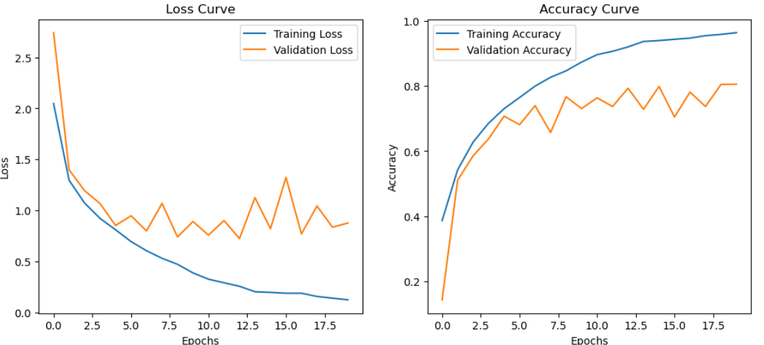
CIFAR-10 DATASET
Lenet-5 model
Alexnet model

Slide 15
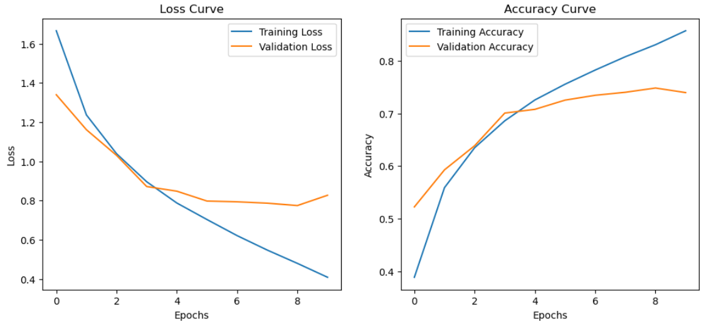
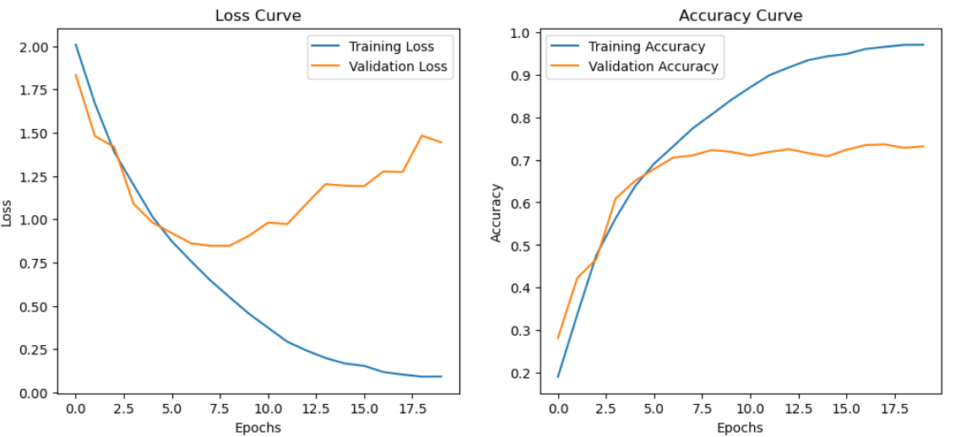
CIFAR-10 DATASET
Googlenet model
Vggnet model

Slide 16
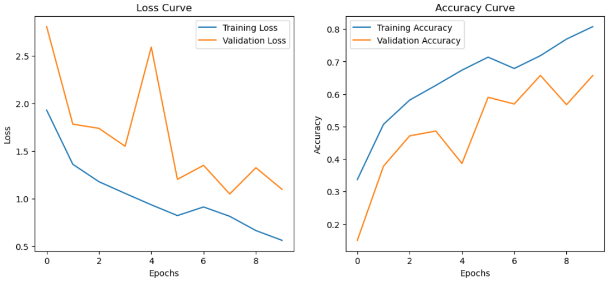
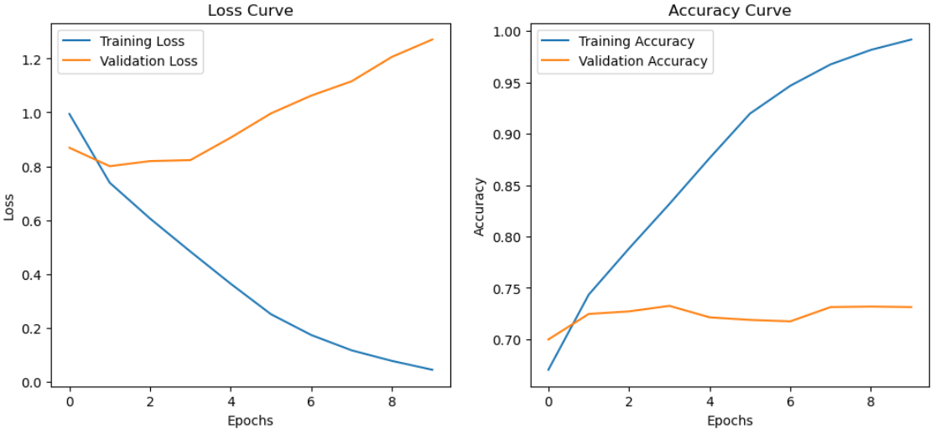
CIFAR-10 DATASET
Resnet model
Xception model

Slide 17
CIFAR-10 DATASET
Senet model

Slide 18
MNIST Dataset
Best Performing Architectures are:
Alexnet
Googlenet
VGGnet
Senet

Slide 19
Fashion MNIST Dataset
Best Performing Architecture :
VGGnet

Slide 20
CIFAR-10 Dataset
Best Performing Architecture :
Alexnet

Slide 21
Loss curve
Overall MNIST Dataset is having very less loss values compared to other datasets.
In CIFAR-10 Dataset, VGGNet architecture showing high loss values.

Slide 22
Observations
MNIST performs well on most of the architectures
CIFAR-10 was not at all good with most of the architectures
LeNet-5 and GoogleNet Performs well on simpler datasets (MNIST and FMNIST) but struggles with more complex datasets (CIFAR-10).

Slide 23
Conclusion
AlexNet is the most robust and versatile CNN architecture among the four examined.
It consistently performs well across both simple and complex datasets, particularly excelling on CIFAR-10
VGG shows high performance on FMNIST but fails to generalize well to other datasets
LeNet-5 and GoogleNet Performs well on simpler datasets (MNIST and FMNIST) but struggles with more complex dataset (CIFAR-10)
ResNet, SENet and Xception performs well on simpler datasets and shows moderate performance on the complex dataset

Slide 24
Thank You

